Slide 1

POWER BI PROJECT
[StudyPulse: Student Performance Analytics]
Summer Training — Power BI | [Chandigarh Engineering College]
Presented by
Course
Guided by
Date
[TONY] | [2547252]
[B.Tech — AI&DS]
[Ms. Ashima]
[30 june 2026]

Slide 2
Agenda
01
Problem Statement & Objective
06
Dashboard Walkthrough
02
Dataset Overview
07
Key Insights & Findings
03
Data Model — Star Schema
08
Publishing to Power BI Service
04
Power Query — Cleaning Steps
09
Challenges & Learnings
05
DAX Measures
10
Conclusion & Q&A
2 / 14

Slide 3
01 Problem Statement
What problem does this dashboard solve?
Educational institutions collect student data, but it is difficult to manually analyze large datasets and identify academic trends. This project solves the problem by converting raw student data into meaningful visual insights using Python and Power BI.
3 / 14

Slide 4
Problem Statement & Objectives
The Problem
Target User
Manual analysis of student academic data is time-consuming and inefficient;
This project provides an interactive dashboard to simplify data analysis and reveal performance trends
Students, teachers, and academic staff who need an easy way to analyze student data and understand academic performance through interactive visualizations.
Project Objectives
Connect & clean the raw dataset using Power Query
Design an interactive multi-page dashboard with 5+ visual types
Build a star schema data model with correct relationships
Publish the final report to Power BI Service
Create at least 5 meaningful DAX measures
4 / 14

Slide 5
02 Dataset Overview
The project uses a self-created Excel dataset containing 500 student records and 25 columns. The dataset includes key fields such as Student_ID, Department, Semester, Attendance, Study Hours, Current CGPA, Previous CGPA, Screen Time, Class Participation, and Stress Level, which were used for analysis and dashboard creation
5 / 14

Slide 6
Dataset Overview
[Kaggle]
[Excel]
[5000]
[35]
Source
File Type
Rows
Columns
Key Columns Used
Data Quality Steps (Power Query)
Column | Role in Dashboard
Column | Role in Dashboard
Student_ID | Unique identifier for each student
Department | Compare performance across departments
Semester | Analyze semester-wise performance
Gender | Gender-wise analysis
Study_Hours | Analyze study habits
Removed duplicate rows
Fixed null values in [column]
Changed data types (Date, Number)
Renamed columns for clarity
Filtered out [cancelled/test] rows
[Add your steps here]
6 / 14

Slide 7
03 Data Model
Microsoft Excel (cleaned_student_data.xlsx)
Data Model Type
Single Table Data Model
No relationships between multiple tables are required
Student Performance Dataset
5000 Student Records
25 Attributes (Columns)
7 / 14

Slide 8
04 Dashboard Walkthrough
Pages, visuals, and interactivity
Page 1 – Student Overview
This page provides a summary of student academic and lifestyle data using KPI cards and interactive charts. It helps users quickly analyze attendance, class participation, department-wise performance, and backlogs.
Page 2 – Academic Performance Analysis
This page focuses on comparing current and previous CGPA, screen time, exercise habits, and academic trends. It enables users to understand student performance across different departments and categories.
11 / 14

Slide 9
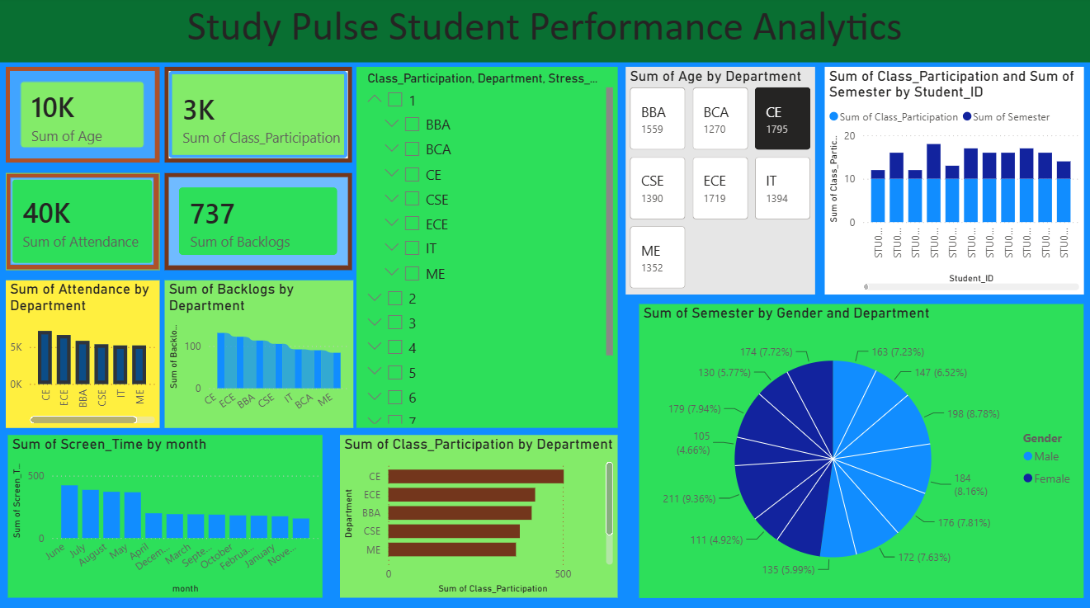
Dashboard — Page 1: Overview
Visuals on this page
KPI Cards — Total Age, Total Class Participation, Total Attendance, Total Backlogs
Column Chart — Attendance by Department
Backlogs by Department Screen Time by Month
Treemap—Exercise Status vs Semester & Weekend Study Hours
[ Screenshot — Overview Page ]
Column Chart — Screen Time by Device Type
Slicer — Department, Class Participation, and Stress Level Filters
Key Insight
The dashboard helps users identify trends in student performance by comparing CGPA, study habits, and lifestyle factors across different departments and student groups.
12 / 14

Slide 10
Key Findings & Insights
[Finding 1 —The slicer showed better attendance and higher class participation compared to most other departments, indicating active student involvementt]
[Finding 4 — Class participation differed across departments, highlighting variations in student involvement in classroom activities]
01
04
[Finding 2 —Students from different departments participated in classroom activities at different levels, showing that engagement varies across departments]
[Finding 5 — The dashboard makes it easy to compare attendance, participation, backlogs, and other academic information, helping users understand student performance quickly....]
02
05
[Finding 3 —Screen time changed throughout the year, suggesting that students' digital device usage is not the same in every month..]
03
13 / 14

Slide 11
Conclusion & Thank You
Successfully built an end-to-end Power BI solution from raw data to published dashboard
The dashboard provides quick insights into student academic performance and engagement.
Used Power Query to clean and transform the student dataset before analysis.
Future scope: Expand the dashboard with AI-powered academic insights.
Questions & Feedback Welcome
14 / 14

